Slide 1
Solutions For Client migration from Ecv2 to Ecv3

Slide 2
Systems sharing same Eyecloud ID with different Eyecloud version : Issue
Share the UOID with Systems 2
Orchstra (Ecv2)
4
SAP (Ecv3)
POST a Document with the UOID gotten from Orchestra
UOID not present, Impossible to store document
8
5
Return UOID
To Orchstra
3
1
Ask UOID to Eyecloud
Eyecloud API V3
Eyecloud API V2
UOID not present
7
6
Check if ID is present before posting Document on It
Create and Save the UOID in DynamoDB
2
UEID
UFID
ULID
UOID
ECID
S3 bucket
S3 bucket
S3 bucket
S3 bucket
S3 bucket
DynamoDB
DynamoDB
DynamoDB
DynamoDB
DynamoDB

Slide 3
Issue faced before the summer about uoid bad pattern : 2.9.2
Share the UOID with Systems 2
Orchestra (Ecv2)
4
SAP (Ecv3)
POST a Document with the UOID gotten from Orchestra
5
8
Impossible to store document
Return UOID
To Orchstra
3
1
Ask UOID to Eyecloud
Eyecloud API V3
Eyecloud API V2
Create and Save the UOID in DynamoDB with a bad pattern
Check the pattern of the ID to know where to post data
6
7
Pattern not known
2
UEID
UFID
ULID
UOID
ECID
S3 bucket
S3 bucket
S3 bucket
S3 bucket
S3 bucket
DynamoDB
DynamoDB
DynamoDB
DynamoDB
DynamoDB

Slide 4
Issue faced before the summer about uoid bad pattern : solution 2.10.2
Share the UOID with Systems 2
Orchstra (Ecv2)
4
SAP (Ecv3)
POST a Document with the UOID gotten from Orchestra
5
9
Document posted succssfully
Return UOID
To Orchstra
3
1
Ask UOID to Eyecloud
Eyecloud API V3
Eyecloud API V2
Check the pattern of the ID to know where to post data and if by any chance the pattern is unknown, the V3 check in all the dynamoDb
Create, check the pattern of the uoid once created and Save the UOID in DynamoDB
Pattern known or ID found
6
8
2
UEID
UFID
ULID
UOID
ECID
S3 bucket
S3 bucket
S3 bucket
S3 bucket
S3 bucket
DynamoDB
DynamoDB
DynamoDB
DynamoDB
DynamoDB

Slide 5
Systems sharing same Eyecloud ID with different Eyecloud version : Solution 1a (Ecv3 Check IDs presence from multiple DynamoDB)
Share the UOID with Systems 2
Orchstra (Ecv2)
4
SAP (Ecv3)
POST a Document with the UOID gotten from Orchestra
5
8
Document is created successfully
Return UOID
To Orchstra
3
1
Ask UOID to Eyecloud
Eyecloud API V3
Eyecloud API V2
ID is present and document has been saved on ECID bucket
Create and Save the UOID in DynamoDB
6
7
2
Check if ID is present in Both ECID and UOID dynaoDb before posting Document on It
UEID
UFID
ULID
UOID
ECID
S3 bucket
S3 bucket
S3 bucket
S3 bucket
S3 bucket
DynamoDB
DynamoDB
DynamoDB
DynamoDB
DynamoDB

Slide 6
Systems sharing same Eyecloud ID with different Eyecloud version : Solution 1b (ECv2 Check IDs presence from mutliple DynamoDB)
Share the ECID with Systems 2
Orchstra (Ecv3)
4
SAP (Ecv2)
POST a Document with the ECID gotten from Orchestra
5
8
Document is created successfully
Return UOID
To Orchstra
3
1
Ask Ecid to Eyecloud
Eyecloud API V2
Eyecloud API V3
ID is present and document has been saved on ECID bucket
6
7
2
Create and Save the ECID in DynamoDB
Check if ID is present in Both ECID and UOID dynaoDb before posting Document on It
UOID
UEID
UFID
ULID
ECID
S3 bucket
S3 bucket
S3 bucket
S3 bucket
S3 bucket
DynamoDB
DynamoDB
DynamoDB
DynamoDB
DynamoDB

Slide 7
Systems sharing same Eyecloud ID with different Eyecloud version : Solution 2 (Ecv2 Redirection to Ecv3)
Share the ECID with Systems 2
Orchstra (Ecv2)
6
SAP (Ecv3)
POST a Document with the ECID gotten from Orchestra
Document is created successfully
Return ECID
To Orchstra
9
7
5
1
Ask ECID to Eyecloud
Redirection to V3
2
Eyecloud API V3
Eyecloud API V2
4
Get back ECID
from Eyecloud V3
Create and save in the Dynamo DB
3
8
ID is present and document is saved on ECID bucket
UEID
UFID
ULID
UOID
ECID
S3 bucket
S3 bucket
S3 bucket
S3 bucket
S3 bucket
DynamoDB
DynamoDB
DynamoDB
DynamoDB
DynamoDB

Slide 8
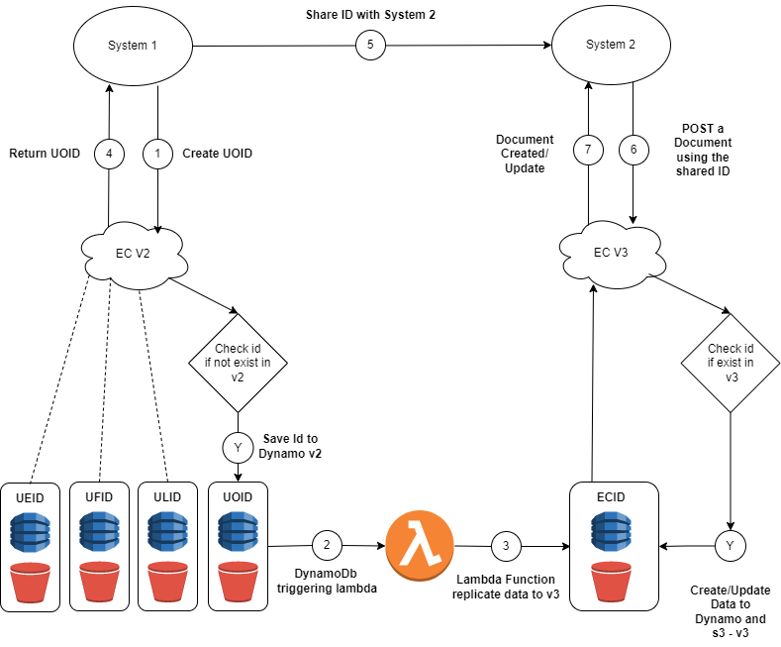
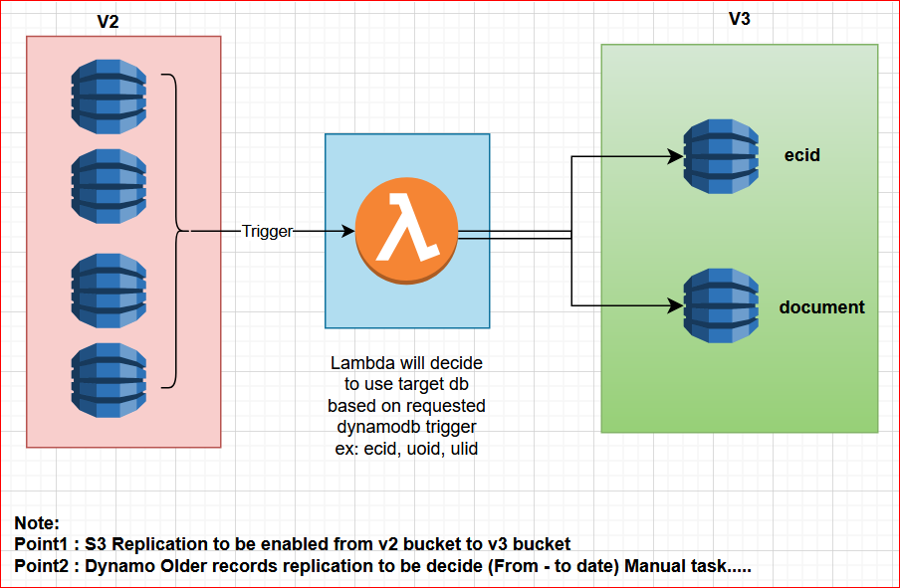
Solution 3 – Lambda Function Create id v2 and Post/Update Document in v3
AWS Flow
Advantages:
Minimal changes in v3 and no changes in v2
Trigger will sync the data from v2 to v3
Generic Lambda Function can be trigger for other IdTypes table.
Disadvantages:
Duplicate record will fail if v2 and v3 have same record. (POST ID)
Note :
Need to think about some retry mechanism if we go with lambda functions trigger.
Data will be replicated from v2 to v3 to sync data
ECID will have a new sort key as IdType [v2 -> ueid,efid,ulid,uoid & v3 ecid] - solution for disadvantage

Slide 9
BBGR system doesn't support the ECv3 ID type : Solutions
​ | Ecv2 | Ecv3 current implementation | Future – Option 1 | Future – Option 2 | Future – Option 3
Case​ | Lower case ​ | Sensitive Case​ | Lower case | Lower case | Lower case
Characters Type​ | 26 letters and 10 digits​ | 52 letters and 10 digits​ | 26 letters and 10 digits | 26 letters and 10 digits | 26 letters and 10 digits
Excluded Characters​ | No character exclusions​ | No character exclusions​ | No character exclusions | No character exclusions​ | No character exclusions​
Length | 8 characters​ | 12 characters​ | 8 characters | 8 characters for customers involved in traceability and 12 characters for others ​ | 9 characters​ (whatever but more than 8)
Format​ | ueid : AAANAAAA​​ uoid : A*N*A*N*​​ ufid: AA**NN​​ ulid : ********​ "A": Letters 26 characters "*": Alphanumeric 36 characters​ "N" : Chiffres 10 characters | Without format​ | Without format | Without format​ | Without format​
Combination​ | Currently BBGR is using uoid format​ Combination 26^2 x 36^4 x 10^2​ | 62^12​ | 36^8 | 36^8 combinations for customers involved in traceability 36^12 combinations for others | 36^9​
Combination result​ | 113 542 041 600​ | 3 226 266 762 397 899 821 056​ | 2 821 109 907 456 | Traceability customers : 2 821 109 907 456 Other customers : 3 226 266 762 397 899 821 056 | 101 559 956 668 416
Pros/Cons For Customers | NA | Too many impacts for Customers (IT & CUSTOMERS) | No Impacts for Customers | No Impacts for Customers | Small impacts for customers
Pros / Cons​ For Application Side | ​NA | No complexity for Application side | As the pattern is same as Ecv2, ECv3 has to check from both infra before generate IDs | The application has to manage such of configuration and the knowledge has to be kept As the pattern for traceability customers is same as Ecv2, ECv3 has to check from both infra before generate IDs | No complexity for Application side

Slide 10
Systems want to get historical documents : Issue
Systems 1 Migrate To Ecv3
Orchstra
Orchstra
Document Posted Successfully
5
1
Post Document with UOID
Unknown ID
8
6
Get Document with UOID
Eyecloud API V2
Eyecloud API V3
Post document in S3 bucket
4
2
Check if the UOID is present in DynamoDB
UIOD is not present
8
7
Check if the UIOD is Present
3
UIOD is present
ECID
ECID DynamoDB
UOID S3 bucket
UOID
UOID DynamoDB
ECID S3 bucket

Slide 11
Systems want to get historical documents : Solution
Orchstra Migrate To Ecv3
Orchstra (Ecv2)
Orchstra (Ecv3)
Document Posted Successfully
5
1
6
9
Document retrieved Successfully
Post Document with UOID
Get Document with UOID
Eyecloud API V2
Eyecloud API V3
Check if the UOID is present in DynamoDB
7
4
3
2
Post document in UOID bucket
UIOD is present
Check if the ID is Present either in UOID or in ECID
8
Get Document from ECID Bucket Or from UOID bucket
UOID S3 bucket
UOID
UOID DynamoDB
ECID
ECID DynamoDB
ECID S3 bucket

Slide 12
Ecv2 and Ecv3 sharing the same bucket to stop feeding the historical bucket.
Orchstra (Ecv2)
Document Posted Successfully
5
1
Post Document with UOID
Eyecloud API V2
Post Document in ECID bucket
4
ECID S3 bucket
UIOD is present
3
2
Check if the UOID is present in DynamoDB
UOID DynamoDB

Slide 13
Purge feature
Purge by FileType
Possibility to purge with application/actor keys and date range as inputs
Usage of a dedicated Lambda triggered by an auto scheduler to automate Purge Api Call
Purge concerns only the Files but not the IDs
Infra side purge with TTL configured on DynamoDB, which triggers a lambda to delete related document from S3
Today
Tomorrow

